Slide 1

Jobbery
Learn how to job before AI decides to rob
Domain 1: Aiversecity Future-Ready Workforce
Team #slaynergy · SDC Hackathon 2026
Notes:
We are team slaynergy, and this is Jobbery: a deadline-based job plan for office workers whose jobs AI is replacing.

Slide 2
As the ability to use AI is steadily decreasing, a call to action is necessary: Use it (AI) or lose it (your job)
Jobs projected to be lost to AI:
US employment at risk due to rapid computerization:
Jobs expected to be highly affected by AI and digitalisation:
9.9% → 7.3%
47%
697,000
To reduce AI’s impact on employment, invest in education, digital literacy, and technical skills.
Workers are at risk of losing jobs to AI if upskilling is not done.
DOSM Job Market Insights, 2022 Q2 to 2026 Q2 (published 18 Aug 2026). Down 27% from the peak; the quarterly series is noisy.
Sasana Kijang, & Mohd Arshad, A. P. D. M. N. (2024, September 19). Assessing AI-Induced job displacement in Malaysia [Academic conference paper].
Human Resources Minister Datuk Seri R. Ramanan, 24 June 2026.
The issue: Many of today’s career tools give scattered and irrelevant AI advice with little to no consideration for long-term career stability.
Notes:
Meet a 27-year-old bank clerk, laid off in November, with three to six months of allowance. In Malaysia, clerical roles were almost ten percent of online job ads in 2022. They are 7.3 percent now. And Anthropic’s Economic Index finds 43 percent of a general office clerk’s tasks already show up in real AI use. Career tools tell her what to do, but with no dates, no sources, and no track record. That is the gap.

Slide 3

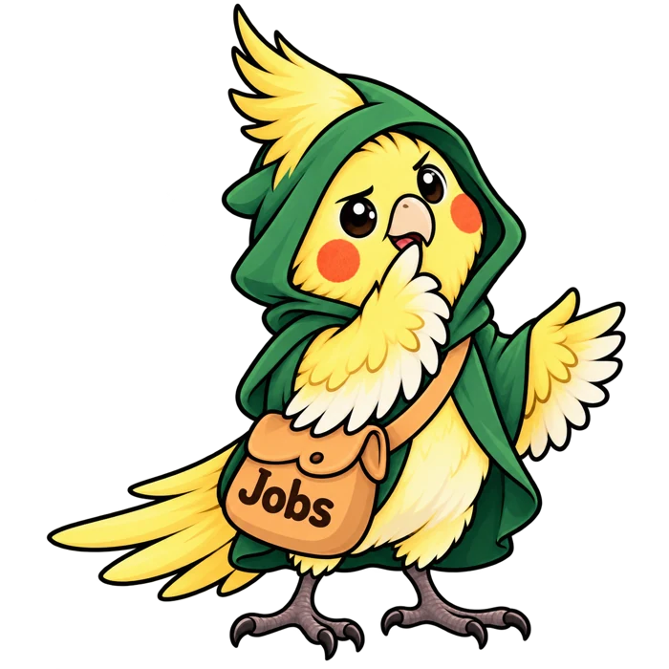
End-to-end human connection: the worker and the advisor
The worker
The advisor
Fresh graduates and members of the workforce
A real person to keep an eye on you, rather than just having an AI on you.
A real deadline with actionable advice, powered by AI
The app needs to know which skills expire, which jobs are within reach, and what to learn this week
The final, innately human, step of the reskilling
Writes advice that lands on the worker’s plan
Pertubuhan Keselamatan Sosial (PERKESO) government servants to give human-centered advice to those who require it
Notes:
Two users. The worker, who needs to know which skills expire and what to learn each week. And the advisor, who meets each worker once and sees their profile and plan.

Slide 4


Skills intake
Built-in résumé scanner which extracts skills while giving the user input to improve their resume.
AI-trend signal layer
Dated and trusted public sources, updated whenever new data is published
Role matching and skills gap
Discover which of your skills are at risk of becoming redundant and which skills should be prioritized.
Reskilling pathway
Actionable weekly steps, with links to free courses, completed with a quick call with a human advisor.
SDG mapping
A focus on SDG sub-targets of SDG 4.4, 5.7, 8.5, 9.2 and 10.3
Handling uncertainty
Shows the skill changes for the cases of slow, medium and fast AI progression.
Notes:
All six must-haves, each on a named screen: intake on You, the trend layer on Trends and Sources, matching on Jobs, the pathway on Plan, SDG goals four, eight and ten on Goals, and the scenarios on Futures.

Slide 5
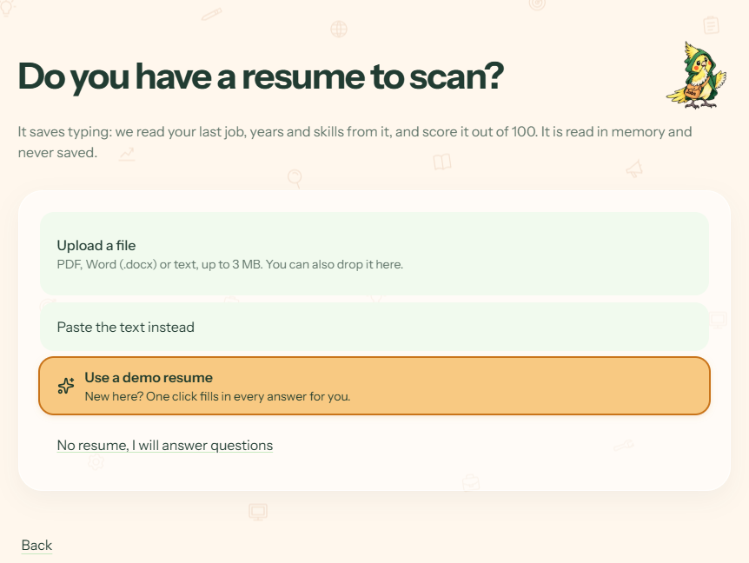
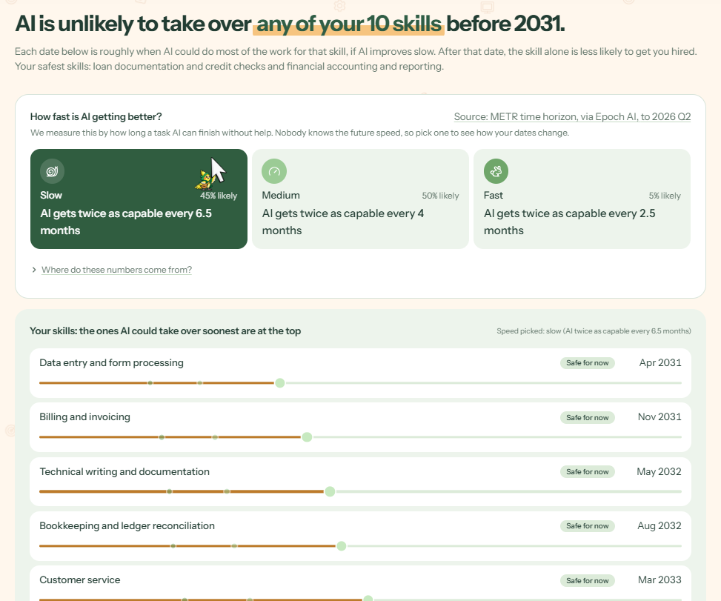
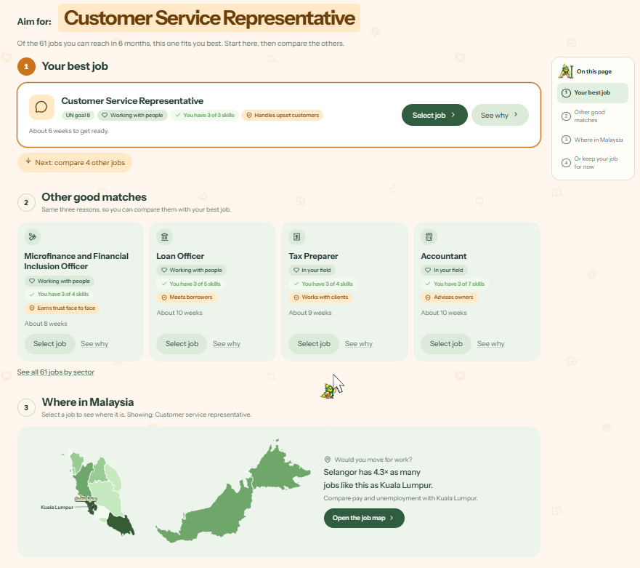
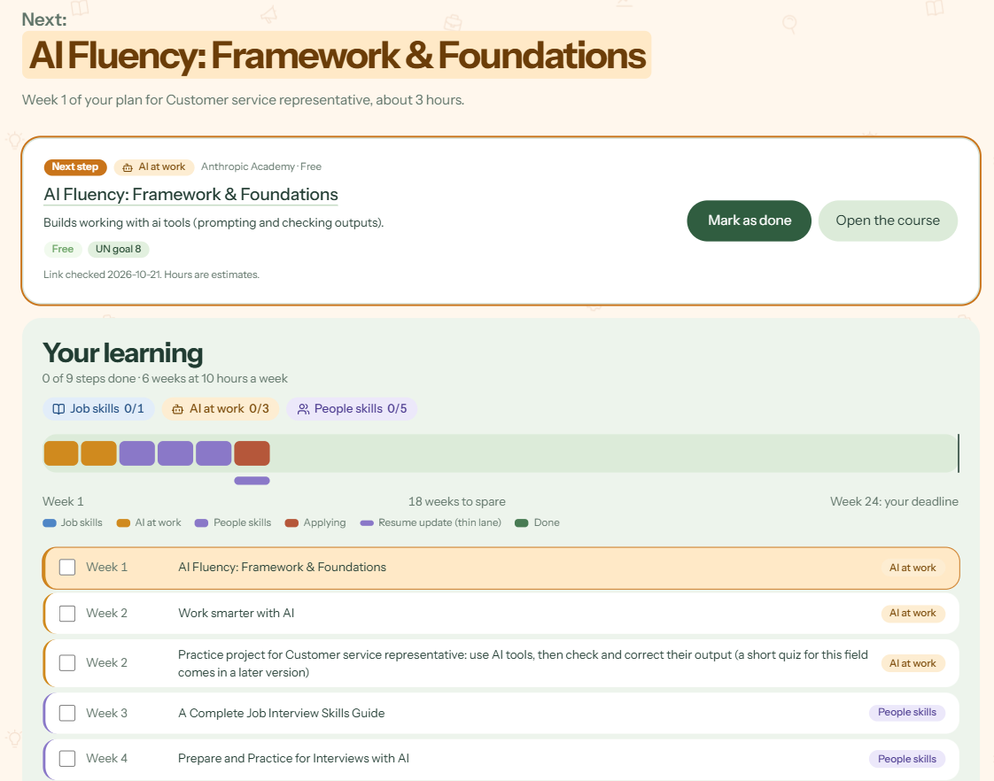
From résumé to roadmap in four simple steps.
›
›
›
You
Skills
Introduce yourself, then scan a résumé or answer eight questions. Nothing is stored.
Jobs
Every skill gets an expiry date, under conditions of either slow, medium or fast AI progression.
Plan
Roles you can reach, and the skills you need to get there.
Week by week, with free courses, culminating in a meeting with the advisor.
Notes:
Four steps. You: scan a résumé or answer eight questions. Skills: every skill gets an expiry date under slow, medium and fast AI. Jobs: eighty-nine roles, ranked by what you can reach before your deadline. Plan: week by week, with free courses and an advisor meeting.

Slide 6
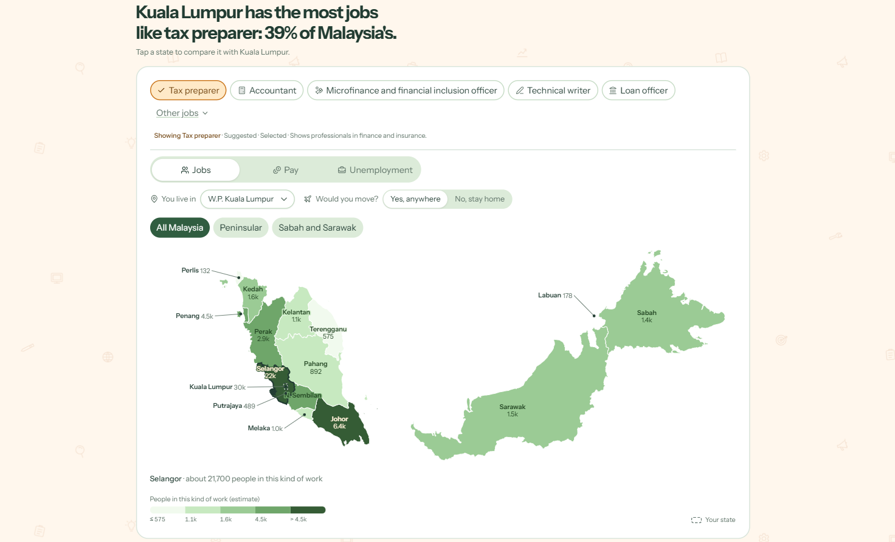
The Geographic Link
Mapping you to the places with the best job opportunities
Jobs distributed around Malaysia
Those willing to relocate can make smart decisions based on job abundance.
Jobbery · Job map
Notes:
What makes it different is the prediction market. Nobody knows how fast AI will move, so we run three futures and let forecasts set the odds. Each question settles against a real public release, like DOSM’s on 17 November. About two hundred simulated forecasters, clearly labelled, built track records by replaying sixty-six real past releases. A hash log, not a blockchain, keeps the record tamper-evident. And this is not a chatbot: no AI model runs inside Jobbery.

Slide 7
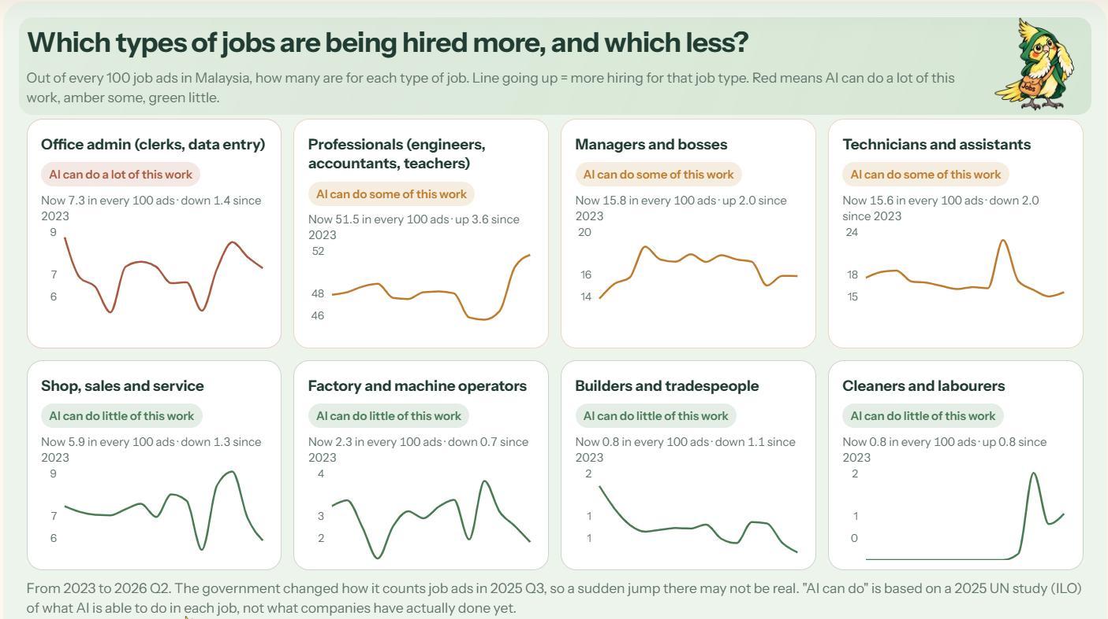
TRACKING THE INEVITABLE AI-CATALYSED CHANGE
The Statistics:
See with Certainty How the Job Landscape is Changing
Government-backed statistics
Which jobs are being hired more, which are being hired less.
Jobbery · Statistics
Notes:
Every source is dated and replaceable. Drop in the next DOSM workbook, run one command, and expiry dates, rankings and plans recompute.

Slide 8
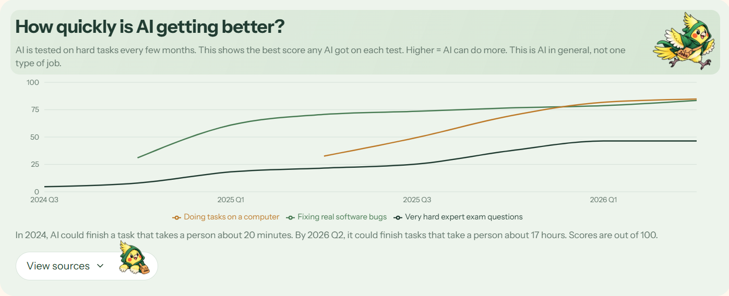
TRACKING THE INEVITABLE AI-CATALYSED CHANGE
The Statistics:
See with Certainty How the Job Landscape is Changing
Government-backed statistics
Shows how AI is progressing, with data from the last 2 years.
Jobbery · Statistics
Notes:
Every source is dated and replaceable. Drop in the next DOSM workbook, run one command, and expiry dates, rankings and plans recompute.

Slide 9
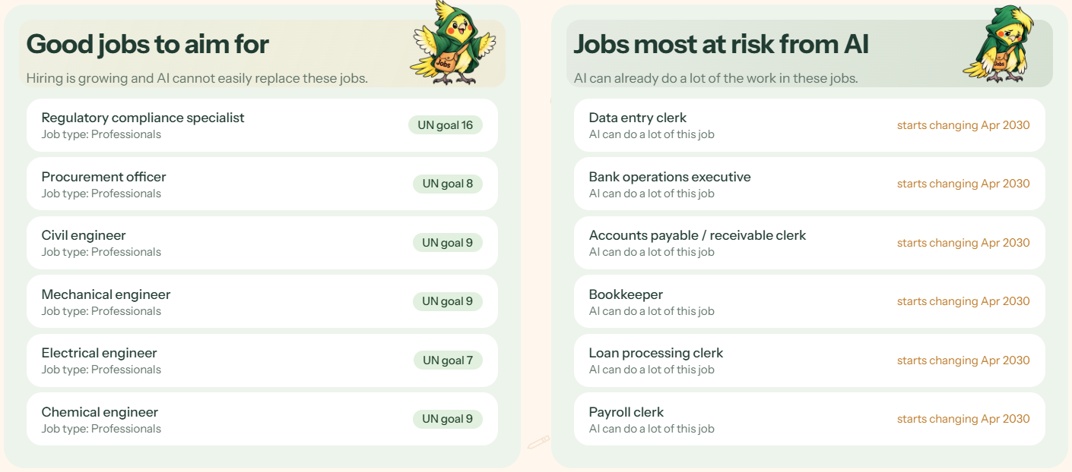
TRACKING THE INEVITABLE AI-CATALYSED CHANGE
The Statistics:
See with Certainty How the Job Landscape is Changing
Government-backed statistics
The best and worst jobs, from a perspective of how future-proof a given job is.
Jobbery · Statistics
Notes:
Every source is dated and replaceable. Drop in the next DOSM workbook, run one command, and expiry dates, rankings and plans recompute.

Slide 10
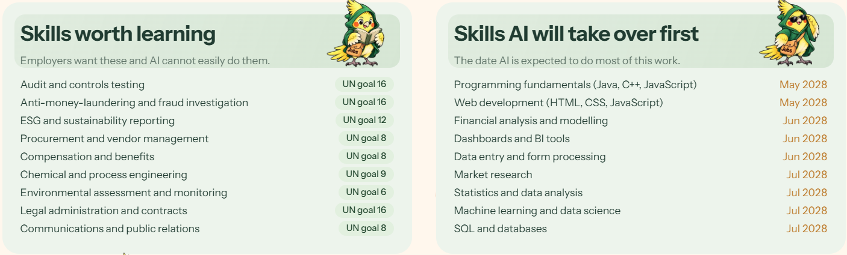
TRACKING THE INEVITABLE AI-CATALYSED CHANGE
The Statistics:
See with Certainty How the Job Landscape is Changing
Government-backed statistics
A list of a skills that are worth learning, as well as the SDGs they are related to.
The skills most likely to be taken over by AI are also stated with their expected “deadlines”.
Jobbery · Statistics
Notes:
Every source is dated and replaceable. Drop in the next DOSM workbook, run one command, and expiry dates, rankings and plans recompute.

Slide 11
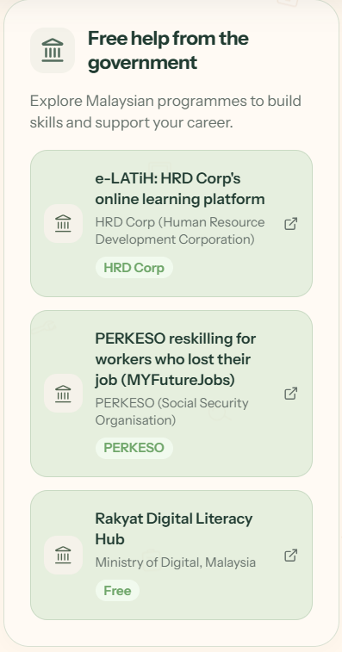
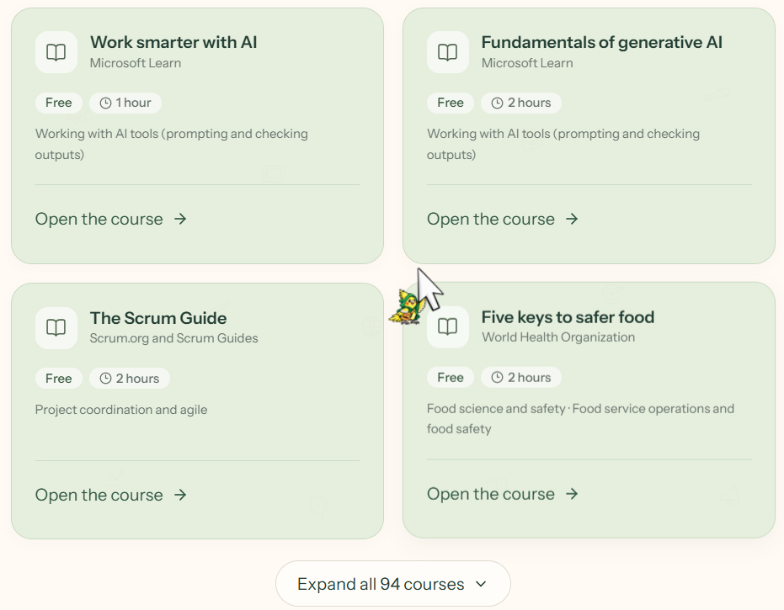
AI-SKILL LEARNING COURSES
Courses:
Hand-Picked, Trusted Providers
Embark on a journey of learning
94 free and low-cost courses from trusted providers, plus Malaysian learning programmes.
Jobbery · Courses
Notes:
Every source is dated and replaceable. Drop in the next DOSM workbook, run one command, and expiry dates, rankings and plans recompute.

Slide 12
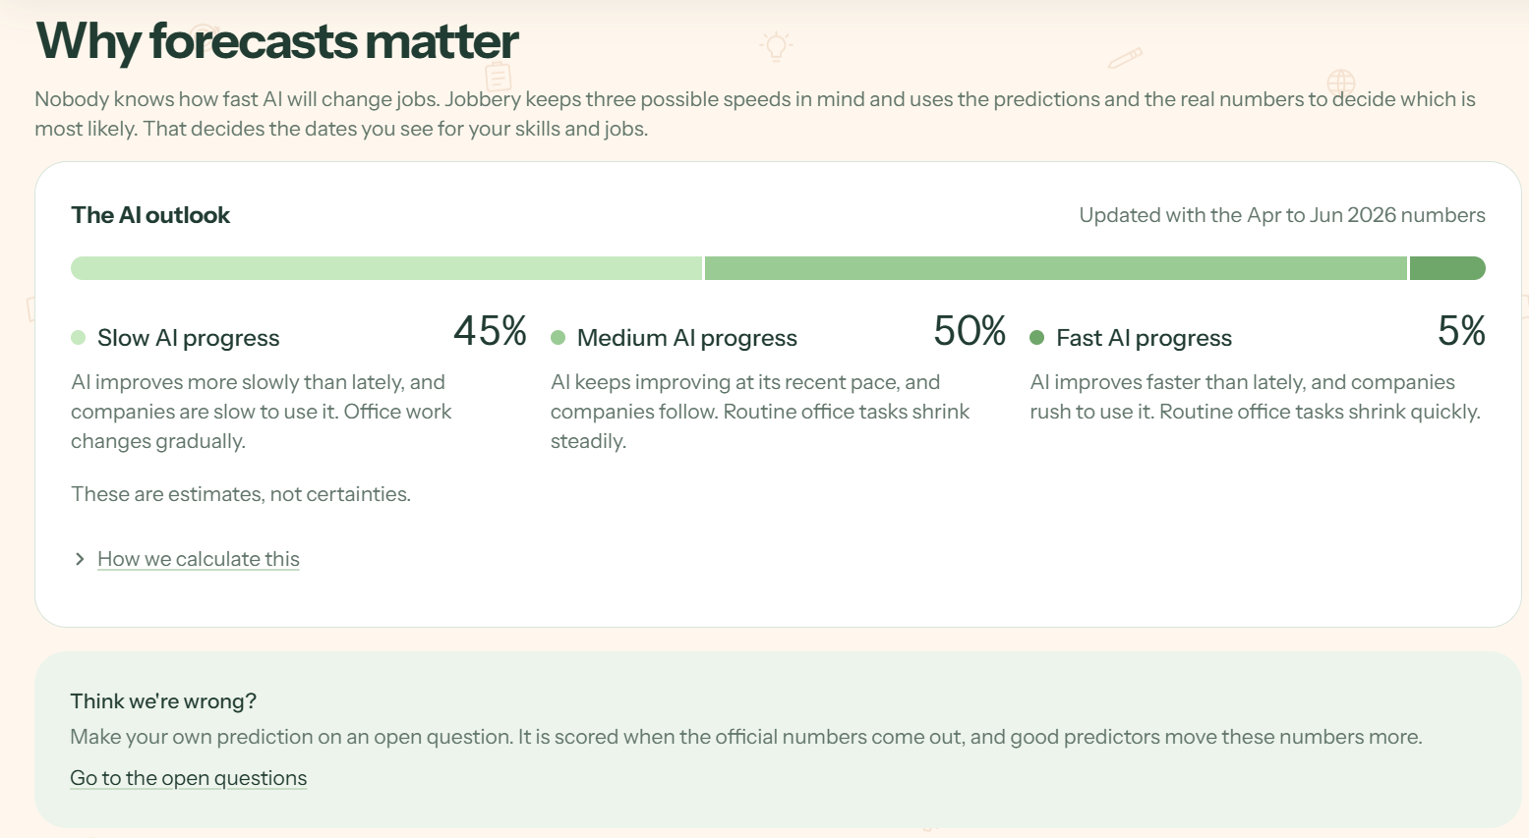
AI-SKILL FORECASTING PAGE
Predicting the Future Livelihoods of Millions
The three futures, with odds
Slow, medium, and fast AI progress. Votes of the forecasters create estimates, not certainties.
Jobbery · Forecast
Notes:
What makes it different is the prediction market. Nobody knows how fast AI will move, so we run three futures and let forecasts set the odds. Each question settles against a real public release, like DOSM’s on 17 November. About two hundred simulated forecasters, clearly labelled, built track records by replaying sixty-six real past releases. A hash log, not a blockchain, keeps the record tamper-evident. And this is not a chatbot: no AI model runs inside Jobbery.

Slide 13
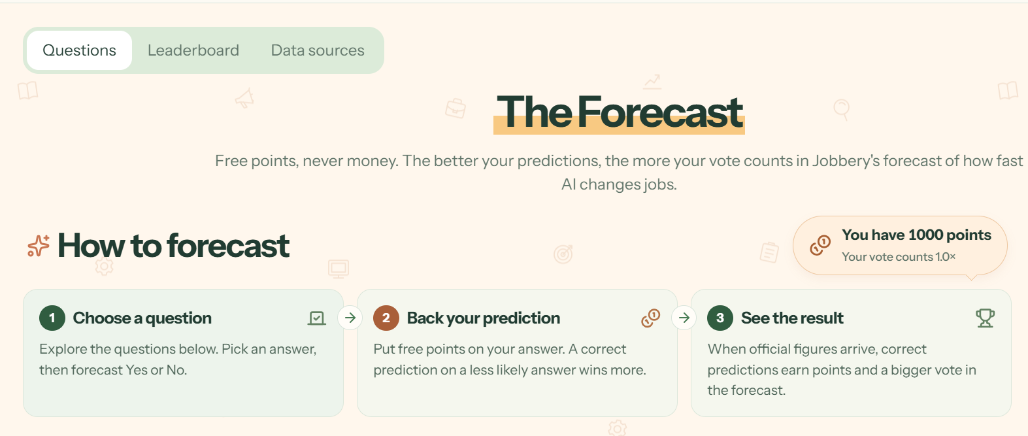
AI-SKILL FORECASTING PAGE
The Forecast:
Don’t Just Think Your Thoughts. Share Them.
Three steps
Choose a question, spend the free points, then see the result. Correct predictions earn points and improve voting credibility.
Jobbery · Forecast
Notes:
Every source is dated and replaceable. Drop in the next DOSM workbook, run one command, and expiry dates, rankings and plans recompute.

Slide 14
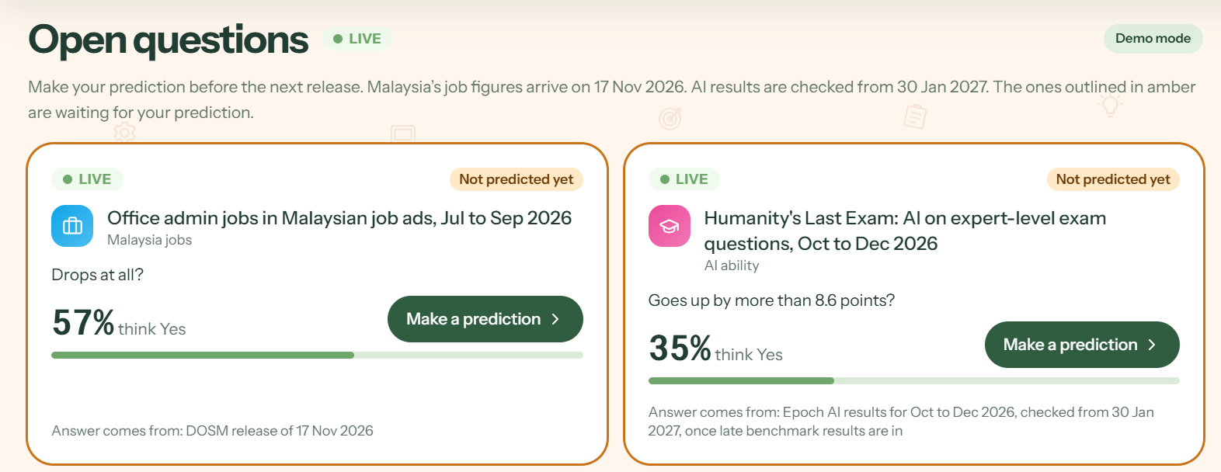
AI-SKILL FORECASTING PAGE
The Forecast:
Don’t Just Think Your Thoughts. Share Them.
Checkable questions
Each card shows the forecasters’ current % and which official news will settle. Amber outlines wait for a prediction.
Jobbery · Forecast
Notes:
What makes it different is the prediction market. Nobody knows how fast AI will move, so we run three futures and let forecasts set the odds. Each question settles against a real public release, like DOSM’s on 17 November. About two hundred simulated forecasters, clearly labelled, built track records by replaying sixty-six real past releases. A hash log, not a blockchain, keeps the record tamper-evident. And this is not a chatbot: no AI model runs inside Jobbery.

Slide 15
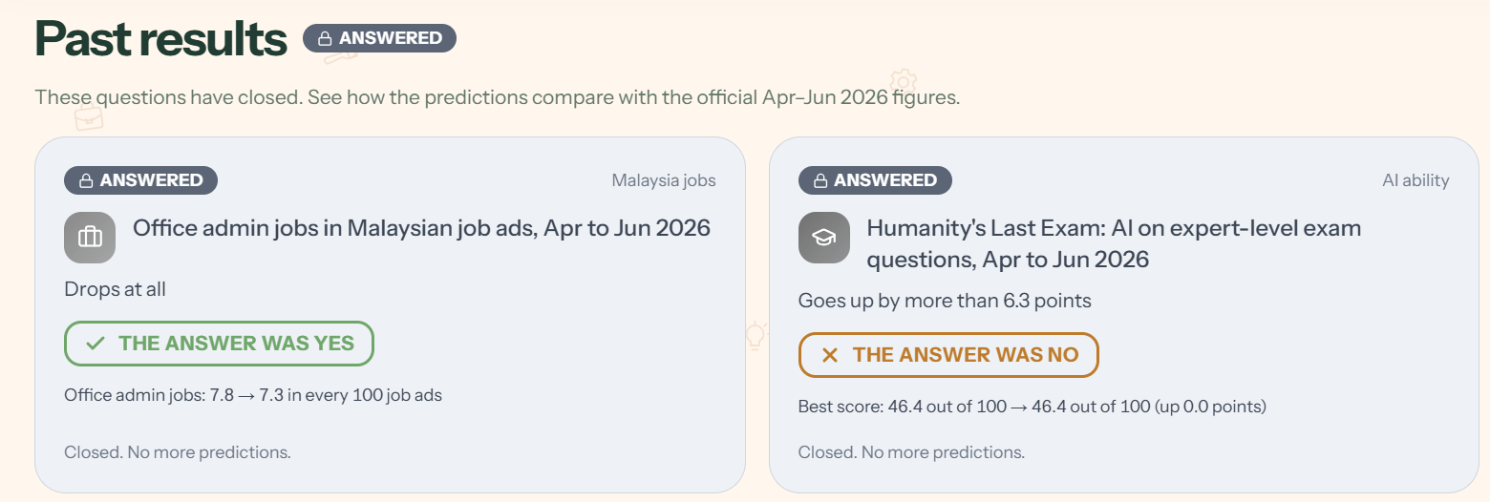
AI-SKILL FORECASTING PAGE
The Forecast:
Don’t Just Think Your Thoughts. Share Them.
Settled by the data
Past prediction results are showcased below. For example, office admin ads fell from 7.8 to 7.3 per 100.
Jobbery · Forecast
8 / 16
Notes:
Every source is dated and replaceable. Drop in the next DOSM workbook, run one command, and expiry dates, rankings and plans recompute.

Slide 16
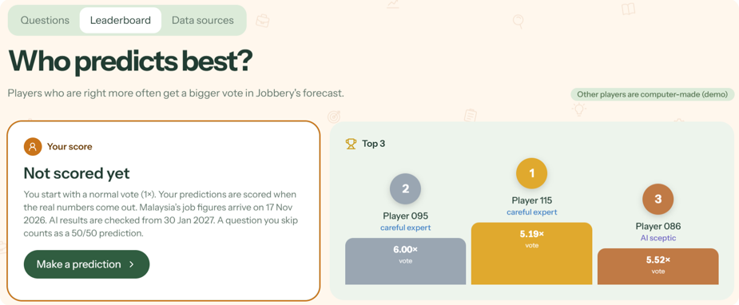
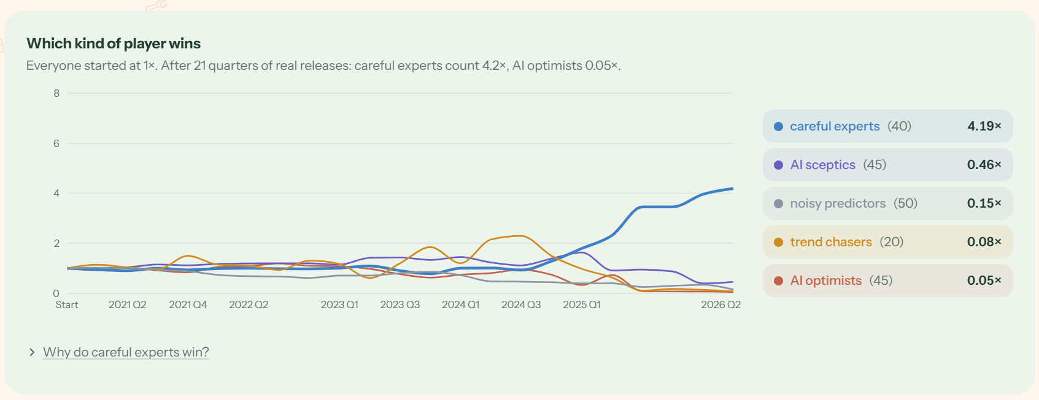
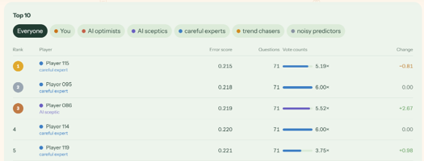
AI-SKILL FORECASTING PAGE
The Forecast:
The Leaderboard
Accuracy earns influence. Making accurate predictions gives you the credibility that amplifies votes and sways future predictions.
Jobbery · Forecast
Notes:
What makes it different is the prediction market. Nobody knows how fast AI will move, so we run three futures and let forecasts set the odds. Each question settles against a real public release, like DOSM’s on 17 November. About two hundred simulated forecasters, clearly labelled, built track records by replaying sixty-six real past releases. A hash log, not a blockchain, keeps the record tamper-evident. And this is not a chatbot: no AI model runs inside Jobbery.

Slide 17
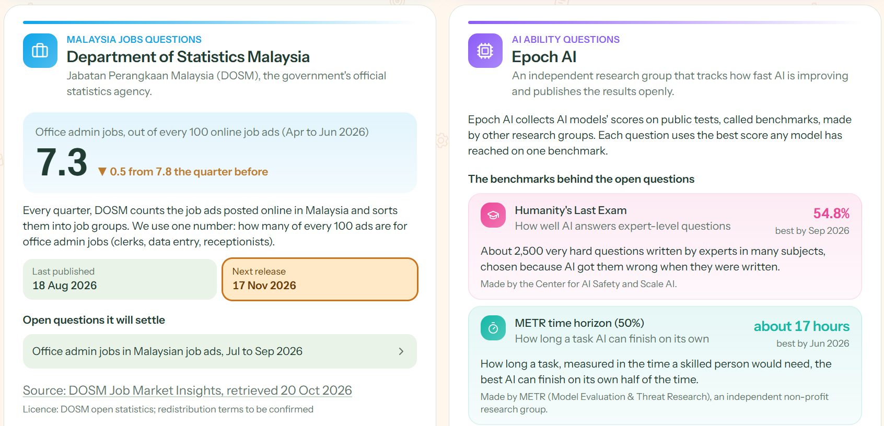
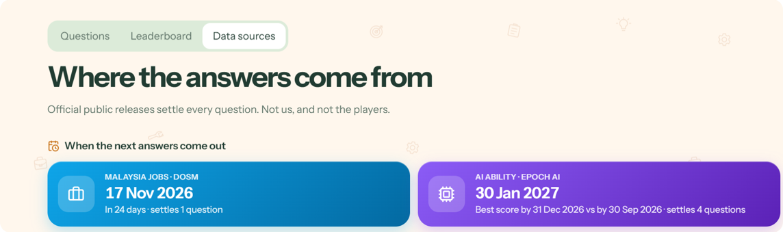
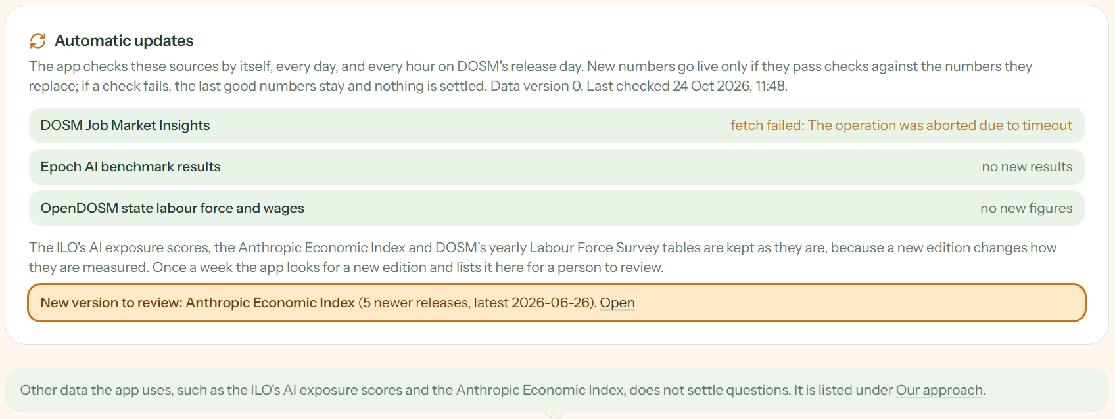
AI-SKILL FORECASTING PAGE
The Forecast:
Hand-Picked, Trusted Sources
Official news settles every question. New numbers go live only after passing credibility checks.
Jobbery · Forecast
Notes:
Every source is dated and replaceable. Drop in the next DOSM workbook, run one command, and expiry dates, rankings and plans recompute.

Slide 18
Trust: Every Source is Dated and Credible
Source | What it feeds | Latest release in the app | Next
ILO | How much of each job generative AI could do | 2025 exposure scores (WP 140) | Next edition
Anthropic Economic Index | Which Economic Tasks are Performed by AI | Release of 10 Feb 2025 | Newer release queued
METR / Epoch AI | How fast AI is improving | Models to 15 Oct 2026 | Jan 2027
DOSM | Job ads by occupation, every quarter | 2026 Q2, published 18 Aug 2026 | 17 Nov 2026
MyCOL | Hard-to-fill occupations in Malaysia | 2024/2025 list | Queued, not loaded yet
O*NET | Role codes and task lists for 89 roles | As bundled in the Feb 2025 Index | With the next Index
One command
Drop in the next workbook and run the build. Open questions settle, the futures re-weight, and every plan recomputes.
Notes:
Every source is dated and replaceable. Drop in the next DOSM workbook, run one command, and expiry dates, rankings and plans recompute.

Slide 19










Tech stack
GitHub:
https://github.com/yabgzichien/SDCHack-slaynergy
Frontend
Next.js
React
TypeScript
Tailwind CSS
Framer Motion
LLM API
Groq
Backend
Node.js
PostgreSQL
SQLite
Notes:
Next.js, React, TypeScript and Tailwind in front, Groq for the language model, and Node and Postgres behind.

Slide 20
Trust: People Stay in Control at Every Step
You choose your path
An advisor, on your terms
Jobbery ranks opportunities and provides personalised recommendations for your next career move. Style the courses, weigh your options, and choose the future you want.
Book a 30-minute meeting anytime. The advisors are present to help you reach your learning goals and career success.
Your call
30-minute slots
Résumés are never stored
Fair by test
Trust us to keep your information private. We keep only the score and the skills you confirm.
Age, gender and background are not requested inputs. We match jobs to you based on skill compatibility alone.
Never saved
Tested on every run
Notes:
People stay in control. Jobbery ranks and explains, but you choose. An advisor can be booked any time, and nothing waits for approval. Résumés are never stored. And a test checks that age and gender never change the results.

Slide 21

The link to UN’s Sustainable Development Goals
SDG 4
SDG 5
SDG 8
SDG 9
SDG 10
Quality education
4.4 Increase the number of people with relevant skills for financial success
Gender equality
5.7 Equal rights to economic resources, property ownership, and financial services
Decent work
8.5 Full employment and decent work with equal pay
Industry, innovation and infrastructure
9.2 Promote inclusive and sustainable industrialisation
Reduced inequalities
10.3 Ensure equal opportunities and end discrimination
Benefactors
Measured metrics
Desired growth
Percentage (%) increase in website users
Percentage (%) of users still relying on the provided AI resources.
Percentage (%) of users who have completed the AI courses and passed the AI quizzes.
User testimonials
Fresh graduates
Employed and unemployed workers in the workforce
Companies who get to future-proof their employees and job postings
Percentage increase of website users over time
Long-term use of AI skills learned through use of the website
Employment of Jobbery users and large-scale deployment of website in public and private sectors
Notes:
Clerks reskill inside their allowance window, and advisors spend meetings on advice. We will measure plans finished before the deadline and time to first interview. It maps to SDGs four, eight and ten, in four languages.

Slide 22
Thank
You
Notes:
Clerks reskill inside their allowance window, and advisors spend meetings on advice. We will measure plans finished before the deadline and time to first interview. It maps to SDGs four, eight and ten, in four languages.

